Slide 1
How to Upload myBlock on Github

Slide 2
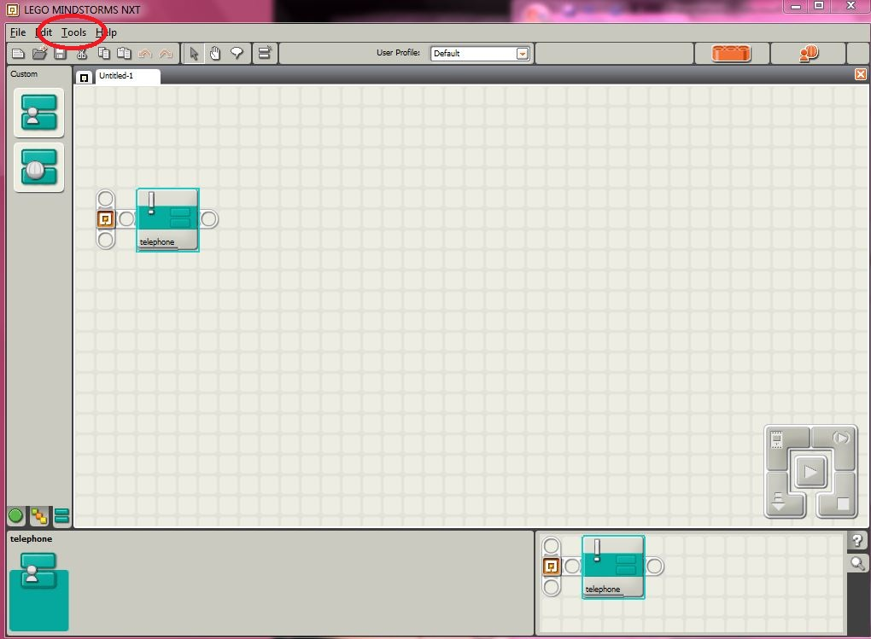
Create Pack and Go
First select your myBlock, or if you want the whole program, select the whole program.
Go to ‘Tools’ and select ‘Create Pack and Go…’

Slide 3
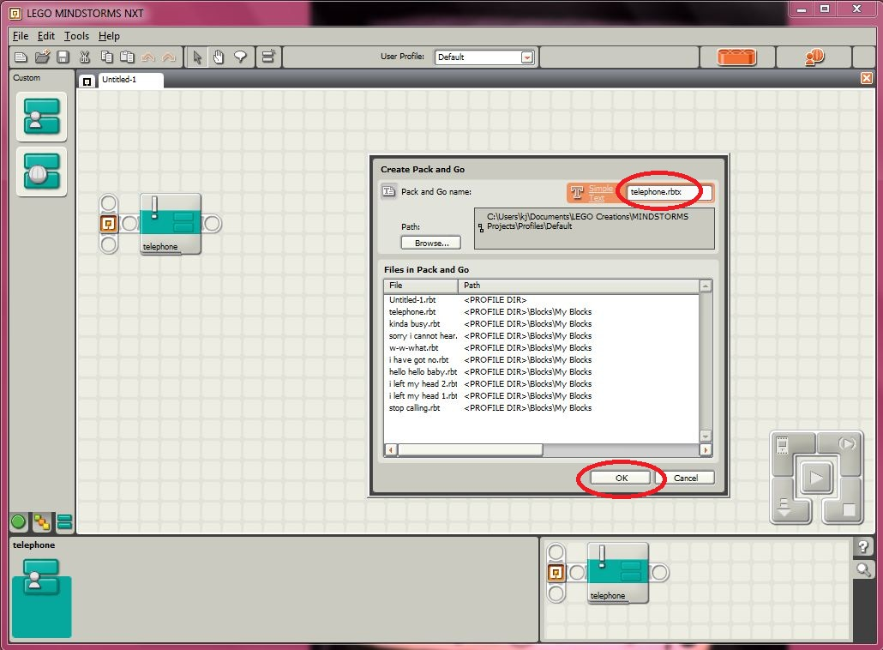
Create Pack and Go (continued…)
CHANGE THE NAME OF THE PACK AND GO! Don’t name it the same thing as the program name because you will get confused over which file to upload. For example, my program was called “Untitled-1” so I changed the myBlock name to “telephone.rbtx”
Click ‘OK’ to make your pack and go.

Slide 4
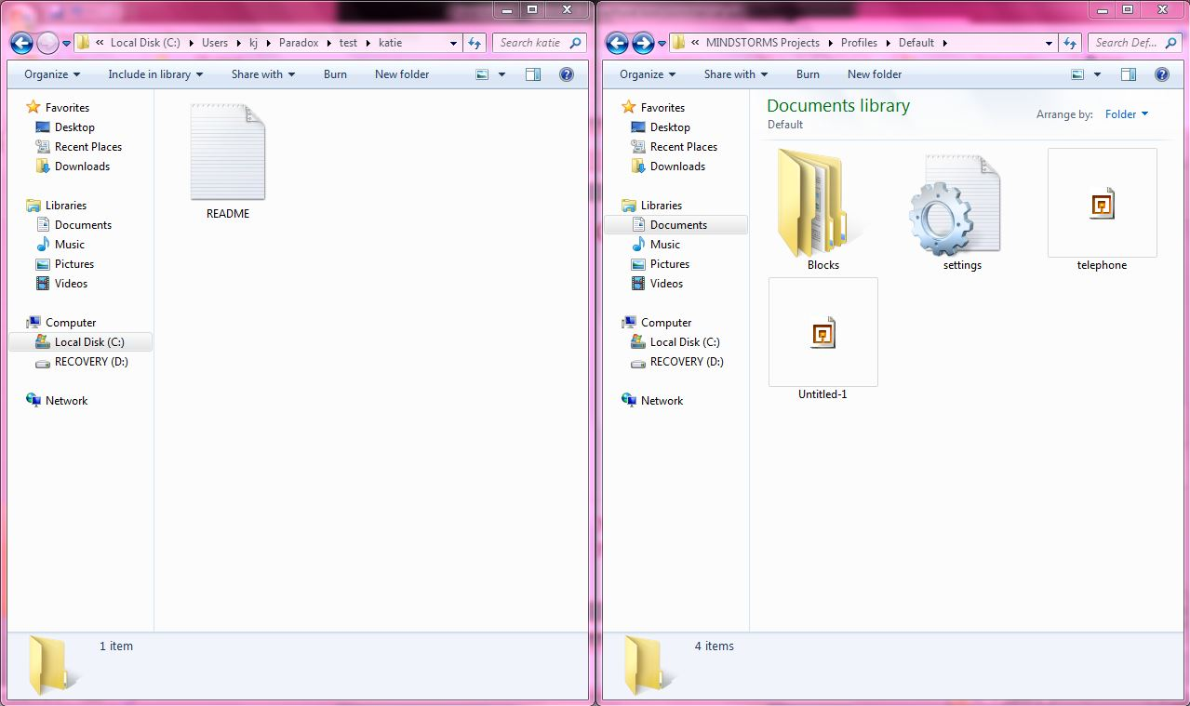
Move the Pack and Go file to the Paradox folder
Just open the Paradox folder (remember to git pull before you do!) and LEGO Creations folder next to each other and copy and paste or drag the file over.
You can save your myBlock, or any other file, in any appropriate folder in Paradox.

Slide 5
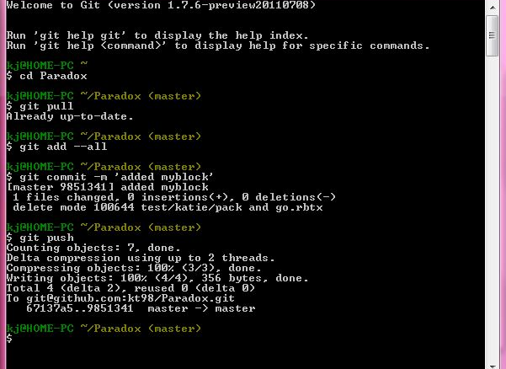
Git push (upload files to server)
Git push the files to the server. Open Git Bash.
Get the latest files…
$ cd Paradox
$ git pull
Check in your myBlock (or other files)
$ git add --all
$ git commit –m ‘your comments’
$ git push

